Slide 1
Thesis submission, defence and evaluation
The content created by the staff from Department of Artificial Intelligence and System Engineering
with the financial support of International Cooperation and Foreign Students Department

Slide 2
Contents
Thesis submission
Defence procedure
Thesis evaluation
Tips for preparing:
  Presentation
  Speech

Slide 3
Thesis submission

Slide 4

Thesis submission steps
1. Print the thesis and bind in hardcover

Slide 5
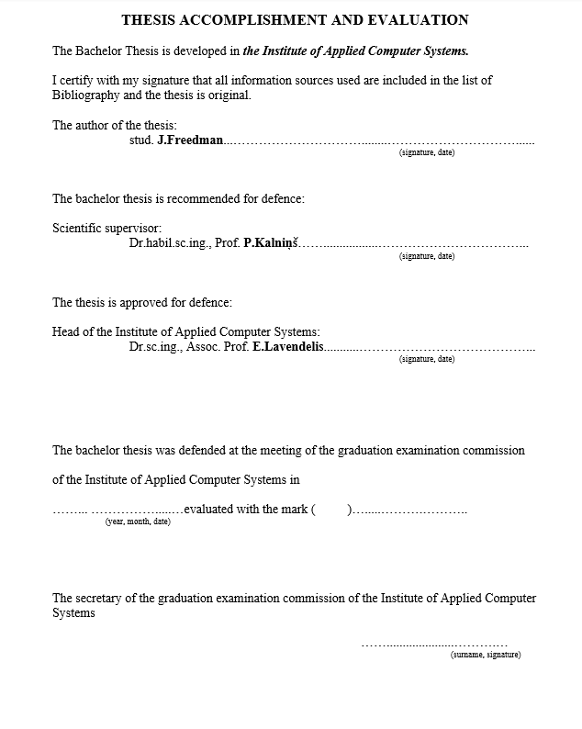
Thesis submission steps
2. Sign thesis accomplishment and evaluation page and ask the supervisor to sign it (located immediately after the title page)

Slide 6
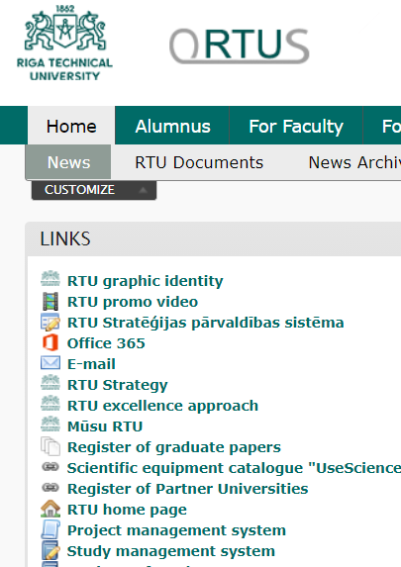
Thesis submission steps
3. Upload the electronic version of the bachelor thesis to the RTU Final Thesis Register in ORTUS:
  Go Home->
  News->
  Register of graduate papers

Slide 7
Thesis submission steps
4. Upload the thesis and print Declaration of the Author of the Graduate Paper
If there is not announced about opportunity to upload your thesis work- contact Sandra Jurika
by phone: 67089108
or e-mail Sandra.Jurika@rtu.lv
There is no opportunity to submit thesis if you have debts in some subjects OR technical fault.

Slide 8
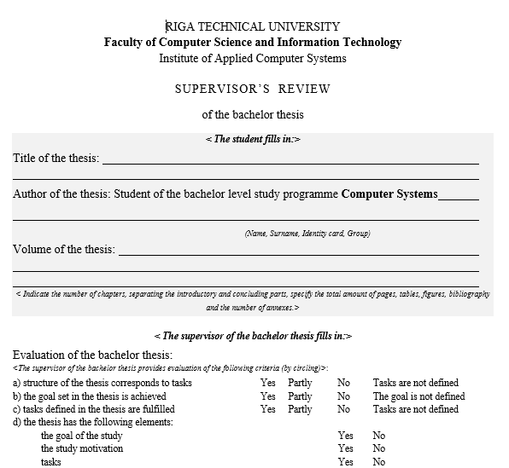
Thesis submission steps
Download “Reviewer’s review” and “Supervisor’s review” and fill-in the student’s part
Print them

Slide 9
Thesis submission steps
Submit
  a bound and signed bachelor thesis,
  signed Declaration of the Author of the Graduate Paper
  review forms
to Silvija Nadeja (email to silvija.nadeja@rtu.lv before submitting hard copy)

Slide 10
Defence procedure

Slide 11
Defence procedure 1/2
Student's presentation (presentation and speech) - 10 min
Questions to the student asked by the members of the commission and others present, and the student's answers to them
The student may disagree with the remarks, but then he/she must prove his/her opinion with constructive and thesis-based arguments.
Reading a reviewer’s review
Reading a supervisor’s review
Student's answers to the supervisor's and reviewer's remarks and final word

Slide 12
Defence procedure 2/2
The student can (if there is the need and time):
  Prepare handouts for the commission
  Demonstrate his/her solution
    if the demonstration requires specific technologies, then the student must install and test them at least 3 days before the defense

Slide 13
Bachelor thesis evaluation

Slide 14
When evaluating a bachelor thesis, it is taken into account
Grade given by the reviewer
Grade given by the supervisor
Student's skills to present and defend their work
Answers to the questions from the defense commission and others after the presentation of the thesis
Quality of the content, formatting, used information sources and language of the bachelor thesis

Slide 15
When evaluating presentation skills, the following is taken into account:
Quality and content of the presentation
Content of the student's speech
Inclusion in the time allotted for defense
Whether the evidence to prove that the tasks defined in the thesis have been fulfilled and the set goal has been achieved was shown during the presentation?
Were the results achieved by the student clearly reflected during the presentation?

Slide 16
Structure of the thesis presentation

Slide 17
Preparing for the defence
Prepare a presentation
Give a presentation to the supervisor to receive comments
Improve your presentation with the comments you received and write a speech
Practice in front of a mirror or listener
Talk to the supervisor to test the speech and presentation a few days before the defense

Slide 18
Structure of the thesis presentation 1/2
ACTIVITY
PRESENTATION CONTENT
Introduces the commission and others to him/herself, the topic of the bachelor thesis and the supervisor
Title slide: 1 slide, mandatory
Inform about the content of the presentation
Content slide: 1 slide, optional
Emphasizes the topicality of the bachelor thesis topic and the essence of the researched problem
Thesis topicality slide: 1-2 slides, mandatory
Defines the aim and tasks of the bachelor thesis
Thesis aim and tasks slide: 1-2 slides, mandatory

Slide 19
Structure of the thesis presentation 2/2
ACTIVITY
PRESENTATION CONTENT
Tells about the work done and the results achieved
Number of slides and their titles depends on the thesis content
Presents the conclusions and proposals, emphasizing own solutions
Conclusion slide: 1-2 slides, mandatory
Indicates possible directions for future work
Further research opportunities slide: 1 slide, optional
Expresses its gratitude to the commission and others and invites for questions or comments
Final slide: 1 slide, mandatory

Slide 20
Title slide and content slide
A title slide must contain:
 | Title of the thesis
 | Supervisor’s name (advisable also occupation and scientific degree)
 | Consultant’s name, if any (organization, occupation and scientific degree)
 | Student’s name
A title slide could also contain
 | An institute where the thesis is defended
 | Defence date
A content slide lists
 | Main sections of the presentation

Slide 21
Topicality slide, aim and tasks slide
Contents of the topicality slide:
 | Tell why this topic or problem is important
 | The task of the work topicality slide is to draw attention to the work, emphasizing its topicality
An aim and tasks slide
 | Remember that the goal of the thesis must be specific and measurable (measurable that it has been achieved)
 | Tasks must follow from the aim defined and be allowed to achieve it
 | When presenting the thesis, it must be proved that all tasks have been completed and the goal has been achieved

Slide 22
Slides of work done and results
Content of the slides of work done and results:
 | These slides are directly related to the information provided in the main sections of the thesis
 | The presentation should provide an explanation of key terms and / or ideas. At the same time, you have to focus on exactly what you did yourself, what analytical results you have reached.
 | Key terms and ideas are those that allow listeners better to understand your work and, in particular, your contribution to the problem.
 | For demonstration of the practical results some animated gifs or videos could be used.

Slide 23
A conclusion slide
Content of the conclusion slide:
 | This is not a summary; this is not a list of things done
 | That's what listeners should remember
 | Exactly what you concluded after the development of the analytical and practical part of the thesis and the verification of the solution
Notes:
This is not a summary, this is not an enumeration
That's what listeners should remember

Slide 24
A further work slide
Content of the further work slide
 | Add this slide only if you really see opportunities for you or other researchers to continue work with your thesis in the future
 | Show that you can analyze and see perspectives

Slide 25
A final slide
Content of the final slide
 | At the end of the presentation: thank the listeners for their attention Invite listeners to ask questions and comment
 | In addition, you can add your contacts or link to project repository (for example, in GitHub)

Slide 26
Presentation preparation tips

Slide 27
Presentation preparation tips: general 1/2
Slide contents:
 | Reflect key bullet points, not all of the text you want to tell
 | Emphasize the essentials, not the details The peculiarity of long-term memory: only 1 or 2 things will remain in the memory of the listeners of the presentation
 | Put structured information
Slide numbering:
 | Don't forget to number the slides so that the commission can refer to them when asking questions, and you when answer.

Slide 28
Presentation preparation tips: general 2/2
Amount and text:
 | Don't put a lot of text on one slide, but stick to the principle - one idea per slide
 | If you put too much text in small font size, your audience won't read it: Too much text makes the slide opaque and difficult to read Why should an audience spend their energy reading a text if you tell it? The speed of human reading does not match the speed of listening; instead of helping to understand, the text can be confusing

Slide 29
Presentation preparation tips: fonts 1/2
Font size:
 | Font size for slide headings must be at least 28 pts
 | Font size for text must be not less than 18 pts
 | Do not capitalize whole text: this makes the text difficult to read it dominate over acronyms denies its usefulness in emphasizing some words
Style:
 | Choose and follow the same style throughout the presentation, i.e. fonts, colors, styles, etc.
 | Use the predefined font and color schemes
 | Don't use too many different styles as it distract

Slide 30
Presentation preparation tips: fonts 2/2
Italics:
 | Use for text in “quotes”
 | Use to highlight or emphasize a thought or idea
 | Use for book, magazine or newspaper titles
Fonts:
 | Choose easy to read typefaces Arial is good and clear Roman, Gothic and Calibri is easier to read than Script or Old English
 | Use 1 or 2 font types
 | To emphasize whole slide change fonts or background

Slide 31
Presentation preparation tips: bullets
When to use:
 | Bullets deal as reminders
 | They help to "prepare" the audience for what you will tell; they also can help to remind what you have said
Size:
 | The smallest acceptable font size is 18 pts
Number:
 | Each text paragraph should 1-2 lines long
 | Maximum number of bullet points in one slide is 6

Slide 32
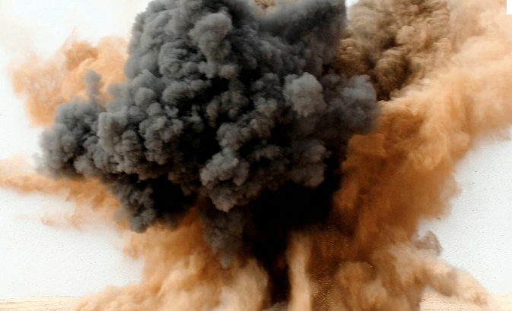
Presentation preparation tips: figures
Figures and tables:
 | If possible, show the results of the thesis as tables, figures and charts
 | One image is worth a thousand words
 | Use images as visual metaphors
Animation:
 | Don't overdo it with animation and visual effects, use them only to draw attention to important aspects of the thesis
 | Your task is to get the audience to focus on “what” you are saying rather than “how” you are doing it, that is, focus on “content” rather than “form”

Slide 33
Presentation preparation tips: colours
Colors:
 | There should be enough high contrast between background and text
 | Use predefined colour schema
 | It is recommended to use no more than 3 different colours (60% of slide with primary colour, 30% with secondary and 10% with accent color)
 | Avoid to use bright and clear hues as the primary colours
Better not
Better not

Slide 34
Speech preparation tips

Slide 35
Speech preparation tips 1/2
Prepare your narrative well so that:
 | Your speech should be fluent and clear
 | What is written in the presentation will not surprise you
 | You could fit in time allotted for defence
Requirements for speech content:
 | The speech must be memorable and emphasize the essentials, not the details
 | The speech should provide more information than is on the slides
 | Be sure to use new words and specific terms, BUT only if you know what they mean and how they are spelled and pronounced

Slide 36
Speech preparation tips 2/2
Requirements for speech style:
 | Speak clearly and so that everyone can hear
 | Speak in full sentences
 | Do not read long monotonous texts from a paper or from slides
Follow the time (10 min.):
 | The time devoted to each slide is approximately 1-2 minutes (so the total number of slides for a 10-minute presentation is 8-10 slides)

Slide 37
Behaviour during defense

Slide 38
Behaviour during defence 1/2
Clothing:
 | A business style should be followed
Behaviour:
 | Behavior during defence must be correct and the rules of business etiquette must be observed if violations of the norms of conduct are stated, the chairman of the commission has the right to suspend the defense and postpone it to another time
 | Look to the listeners and talk to them
 | Do not read from paper or slide
 | Don't stand in front of your on-screen presentation

Slide 39
Behaviour during defence 2/2
Behaviour:
 | Don't be afraid to pay attention to your presentation with gestures and showing something on it
Use of aids:
 | Use a pointer or pen to show something in your presentation
 | Use a timer to follow the time

Slide 40


Answering to questions
Listen very carefully
Ask to repeat the question to make sure you understand it
Answer concisely and clearly
Don't be afraid to admit if you haven't looked at studied something during your research

Slide 41
Conclusion
Create a presentation that contains only the main things that can be told in the allotted time
The main thing is the narrative, the presentation only helps to make it visible
Be proud of your work

Slide 42
This presentation is partly based on:
http://www.scs.ryerson.ca/aferworn/courses/CP8101/CLASSES/EffectivePresentations.pdf

